Slide 1


INNOVACT 25
POWER
KNOCK
Innovation ID: IR2025-995914
An IoT Project

Slide 2
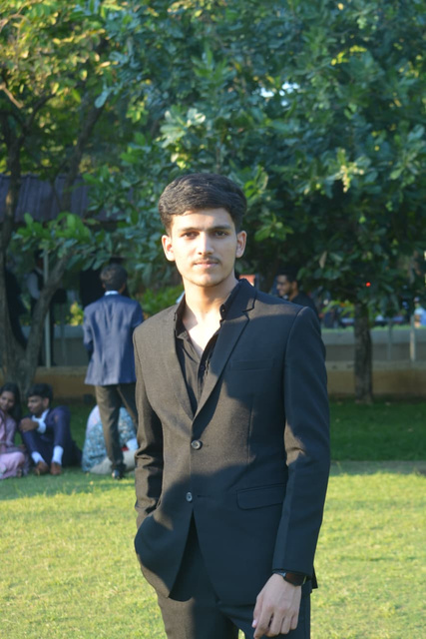




OUR TEAM
Vikesh Kumar
Arun Prasadh R
Anuska Shah
Rohan Raj

Slide 3
PROBLEM STATEMENT
In hostels, lights and appliances are often left on in empty rooms, wasting energy. Traditional locks secure rooms but do not monitor occupancy or control power. There is a need for an intelligent system that combines secure access control with automated power management, ensuring electricity is used only when the room is occupied, while maintaining security for residents.
Traditional Locks are not very secure and can be easily broken into using simple tools. Students keep all of their important belongings in their hostel rooms and they heavily rely on these traditional locks to keep their belongings safe. If something gets stolen, it puts mental and financial stress on the students which can affect their academics.

Slide 4
EXAMPLE SCENARIO
Suppose, a room consists of 4 members, 2 fans and 3 lights. All the members of the room have gone for classes and they forgot to switch-off the lights and fans.
In this scenario, the electricity being consumed by the fans and lights is completely wasted. Our product solves this problem, by cutting off the power when all the members leave the room.
Electricity wastage (standby + misuse): ~15–20%.
Across multiple rooms and blocks, this amount is in crores of rupees yearly.

Slide 5
PROPOSED SOLUTION
PowerKnock is a smart device combining secure access with automated energy management. It uses RFID authentication and a unique knock pattern to allow only authorized users to unlock the door. Room occupancy is monitored using IR sensors, the system automatically switches the power supply on/off. This ensures electricity is used only when the room is occupied, reducing energy wastage while maintaining security. PowerKnock is ideal for hostels, offices, and shared accommodations, providing an integrated solution for access control and intelligent power management.

Slide 6
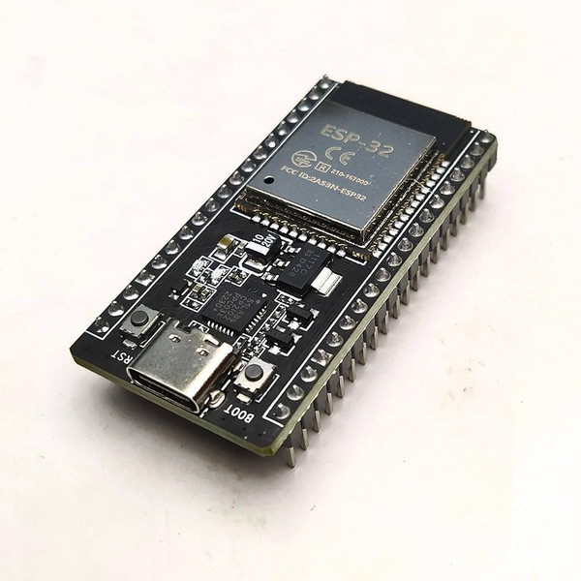
COMPONENTS
ESP32 Module
Infrared Proximity Sensor
PN532 NFC RFID
SW-420 VIBRATION SENSOR
LEDs
5V Single Channel Relay
5V Motor
Servo motor
ESP32 Module

Slide 7
IMPLEMENTATION
User presents an RFID card.
System verifies the card; if authorized, prompts user to enter a knock pattern.
Correct knock pattern triggers a servo motor to physically unlock the door.
Occupancy Detection & Power Control:
IR sensors monitor room occupancy.
Room empty → power supply automatically turns OFF.
Room occupied → power supply remains ON.

Slide 8
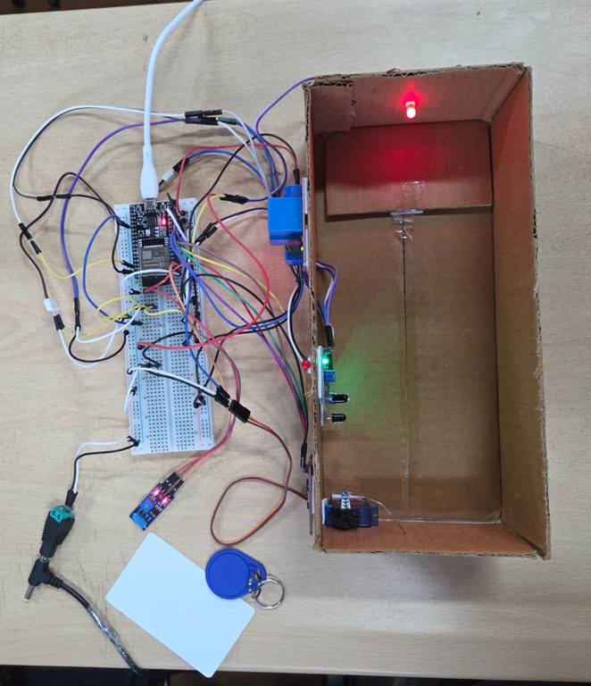
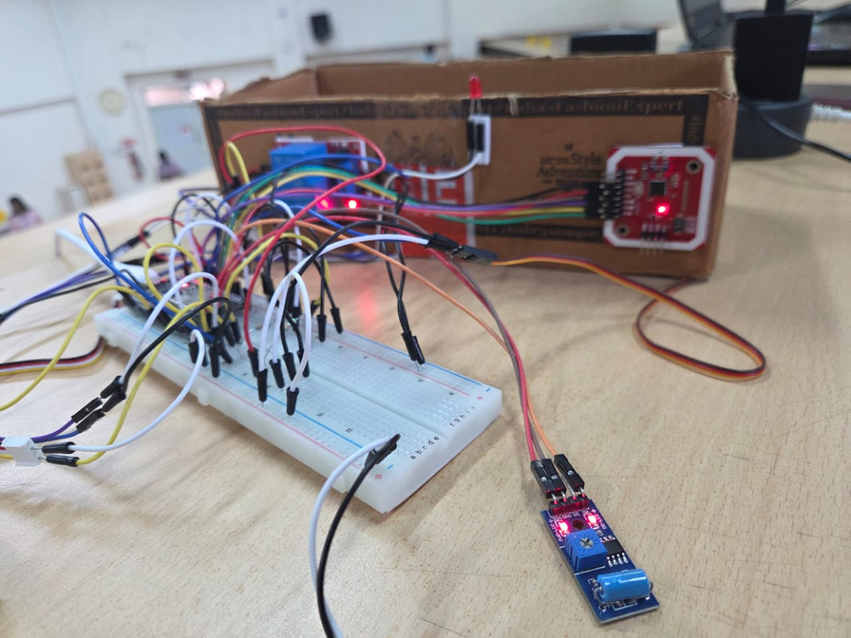
PROTOTYPE

Slide 9
USE CASES
PowerKnock can be used by universities to reduce energy wastage by reducing unnecessary electricity usage in individual hostel rooms which can significantly drive down electricity costs for the University. Reducing electricity wastage can in-turn reduce carbon emmisions.
PowerKnock can be implemented by corporate offices in large board rooms and individual cabins of Employees. This can help reduce their expenditure on electricity and will also help reduce their carbon footprint.

Slide 10
CHALLENGES FACED
Integrating RFID, knock detection, IR sensors, and relay control seamlessly.
Ensuring accurate occupancy detection without false triggers.
Managing power supply stability for ESP32 and connected devices.
Designing a system that is compact, reliable, and hackathon-ready in a short time.

Slide 11
FUTURE SCOPE
If this product is implemented in University Hostels, it can help reduce carbon emissions by a significant margin without any exponential increase in cost. This can help support the environment and is a huge step towards sustainability.
The specific method of combining secure access with automated energy management in a single device is novel and can be considered for intellectual property protection.

Slide 12
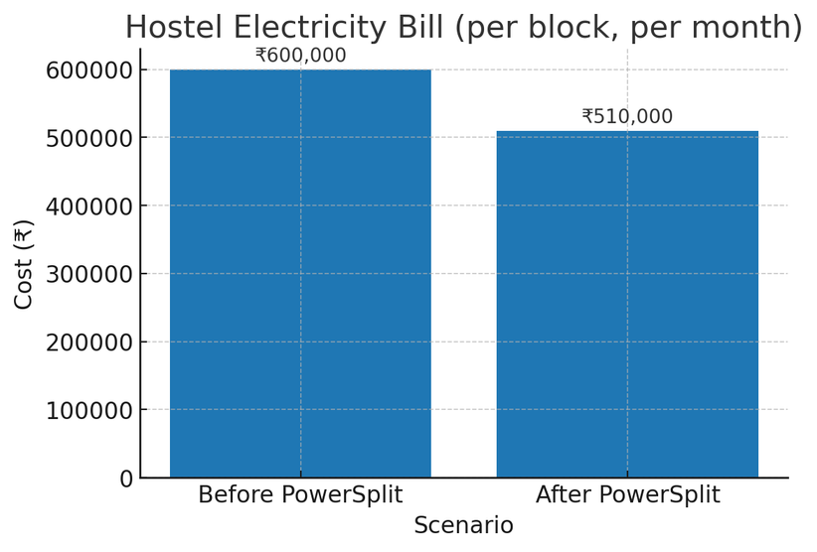
CONCLUSION
PowerKnock is a device that integrates RFID with a knock mechanism, enabling 2FA, which greatly enhances overall security. It also helps us reduce unnecessary electricity consumption by applying an occupancy driven model. It helps companies and institutes lower their carbon footprint and promotes sustainability.

Slide 13
ACKNOWLEDGEMENTS
The parts given to us by the organizers proved to be of great help to us. Without this, the project would not be a success.
We sincerely thank our mentors, guides, and peers for their valuable guidance, support, and encouragement throughout the development of PowerKnock. Their insights helped us overcome challenges and successfully implement the project.

Slide 14
THANK
YOU

